Slide 1

Heart Failure Prediction
March 9, 2022
Katherine Prieto

Slide 2
Introduction/Problem Statement
Congestive heart failure is the most common diagnosis in the United States. Currently, more than 5 million people in the US have congestive heart failure. This number is only projected to increase as our population continues to expand and it is said that one in nine deaths is caused by heart failure.

Slide 3
Problem Statement
That being said, the focus of our study revolves around the question of, can we build a model that can help us determine that given a certain feature set will a patient be diagnosed with myocardial infarction? Our study will focus on specific features like the age of the patient, blood pressure, and sex to predict whether or not a patient will experience heart failure.

Slide 4

Background
Congestive heart failure happens when the heart doesn’t pump blood effectively to the heart as it normally should. There is a common misconception that heart failure means it is about to stop working altogether. In general, heart failure means that the muscle gradually has become less able to contract to provide enough blood to exit the heart. This results in a blockage as the heart is getting blood pumped in faster than it can pump out -- hence congestion.

Slide 5
The Dataset

Slide 6
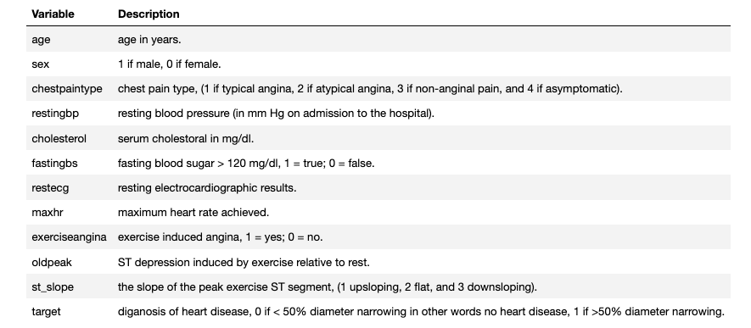
The following dataset was obtained by the UC Irvine Machine Learning Repository. The dataset contains a total of 76 attributes from the Cleveland database that aims to predict the presence of heart disease in patients. We narrow down our attributes to 12 and perform exploratory analysis on the following variables.

Slide 7
Initial Analysis

Slide 8
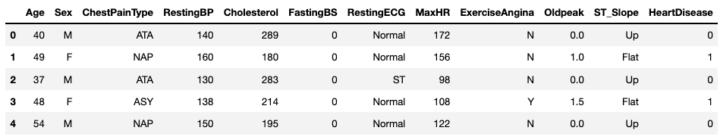

Slide 9
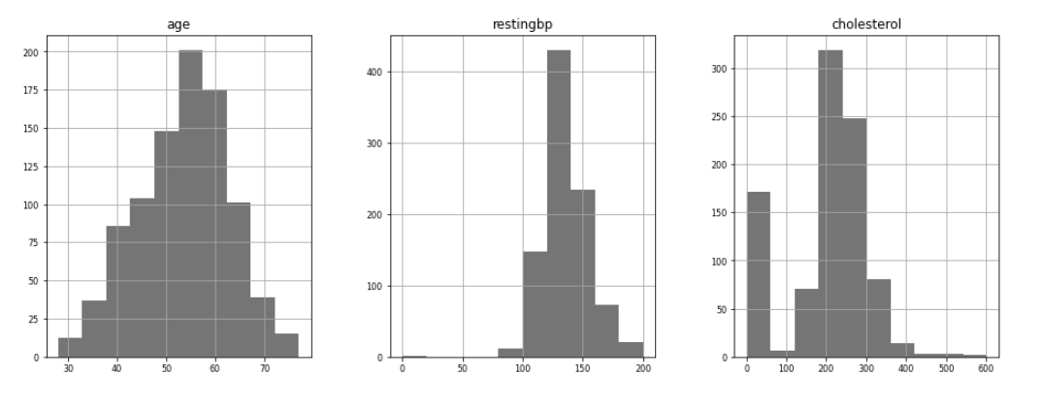
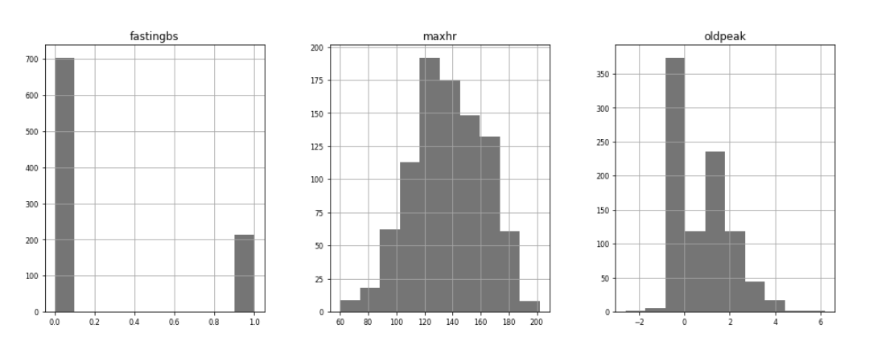
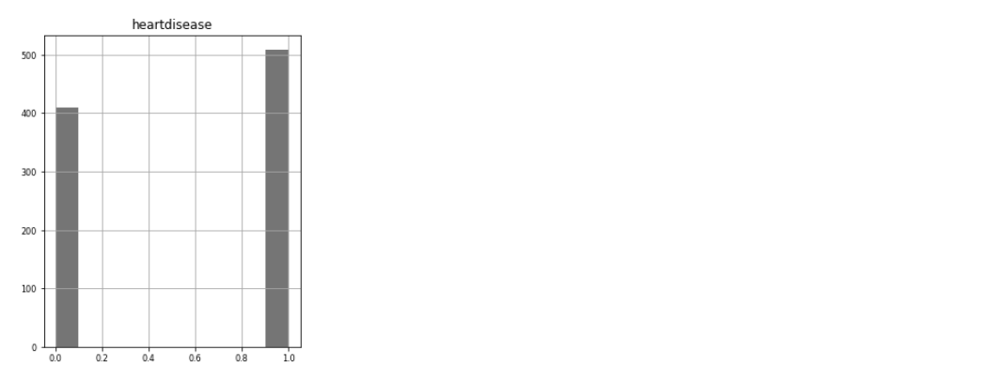

Slide 10
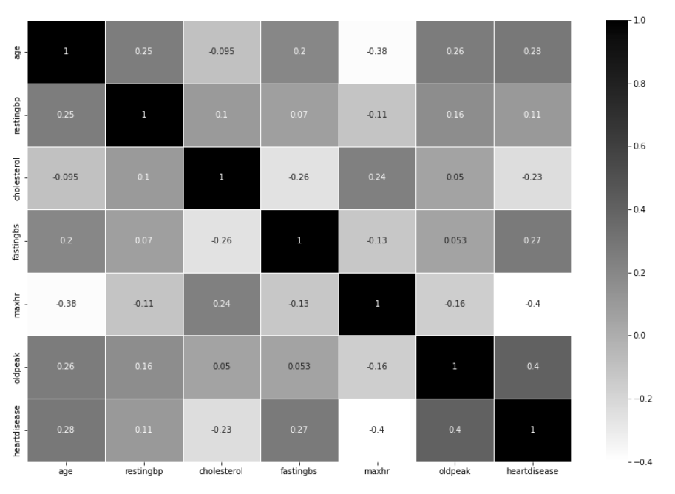

Slide 11
Cleaning up the data

Slide 12
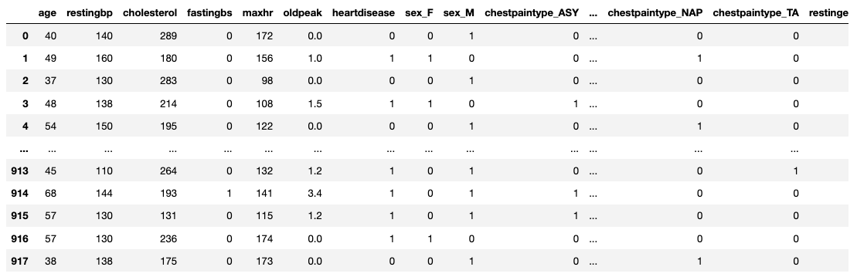

Slide 14
Building Our Model

Slide 15
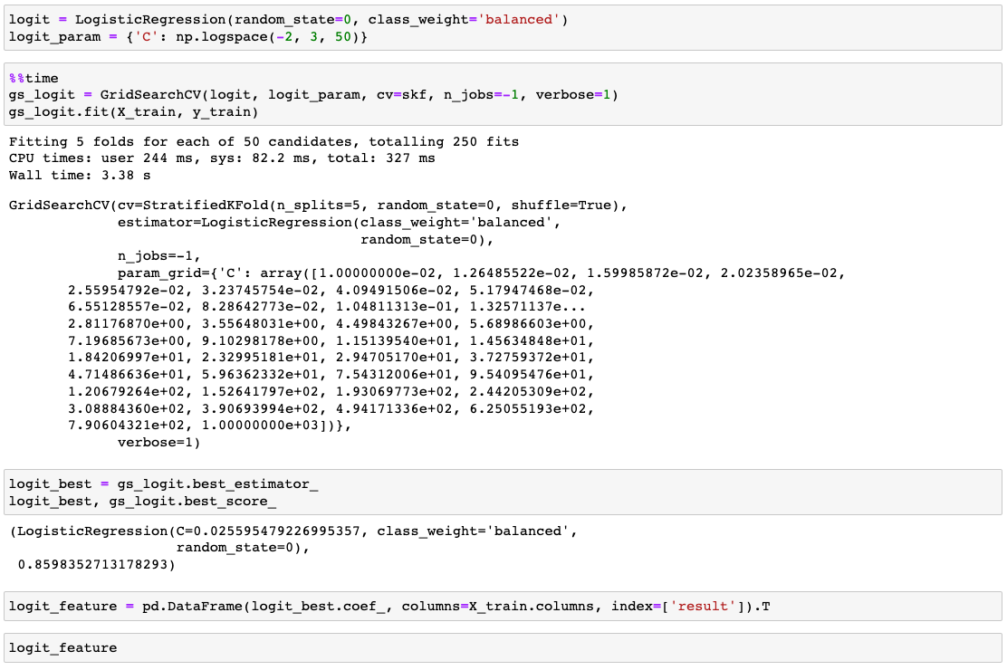
Logistic Regression

Slide 16
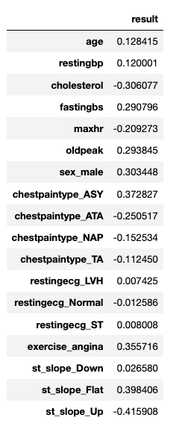
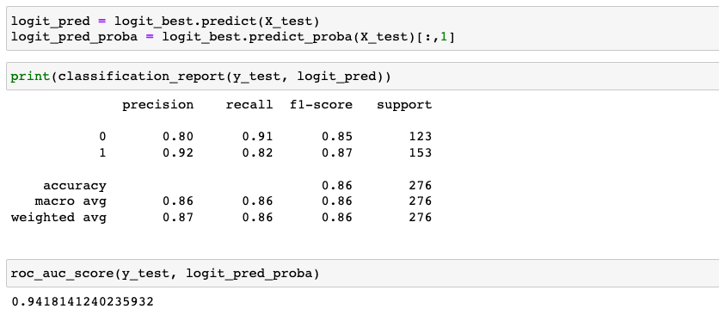

Slide 17
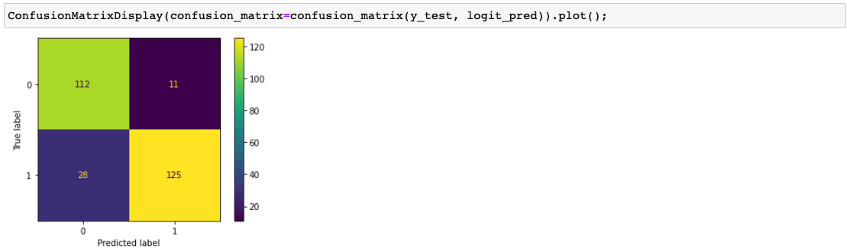

Slide 18
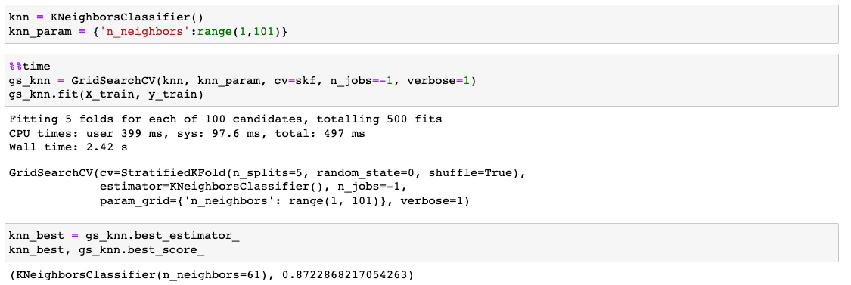
K nearest neighbors

Slide 19
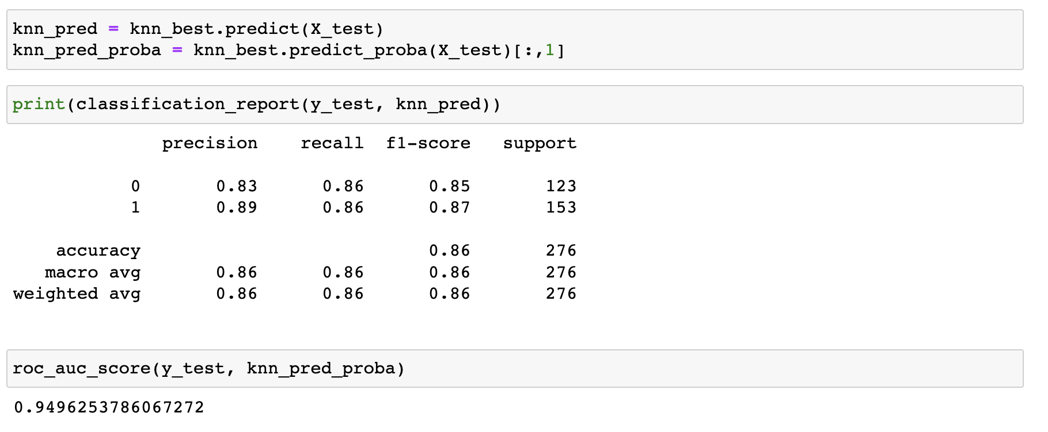

Slide 20
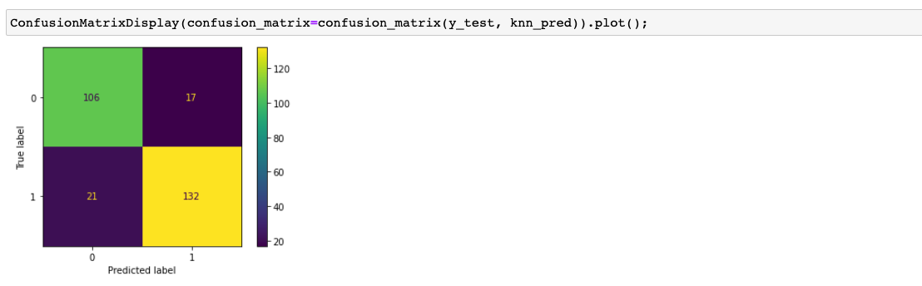

Slide 21

Conclusions

Slide 22
Final thoughts
We want to be able to predict whether a patient has heart failure or not with a certain level of accuracy. This will ultimately aid the healthcare field because having a minimized feature set to predict heart failure cuts down on examination/testing costs for clinics. Congestive heart failure is the most common health issue in the U.S. With the pandemic continuing to spiral in infection rates, and more and more employers opting for a work from home model, increases in congestive heart failure is only expected to increase.

Slide 23
Comparing both models, I would opt to use the logistic regression model in predicting whether or not an individual has heart failure or not. The model’s results show high accuracy rates in predictability and although the model has a lower ROC score, the trade off to roughly a 10% increase in the precision score is reasonable in my opinion.

Slide 24
Going back to our condensed feature set all we need is age, blood pressure, cholesterol, blood sugar levels, heart rate, sex, chest pain type, and the electrocardiogram to be able to predict the presence of heart failure with a ~94% level of accuracy. This will ultimately aide in testing because on average uninsured patients pay roughly $5,000 for the cardiovascular stress test analysis. I’m assuming in California the average should be much higher. Our results in our model show promising results within the field of obtaining 7 to 8 characteristics of every patient to be able to predict whether or not they have heart failure.

Slide 25
Github: https://github.com/Katherinebprieto

